Slide 1
POWERTRAIN

Slide 2
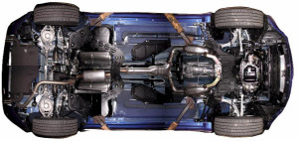
POWERTRAIN:
The powertrain encompasses every component that converts the engine’s power into movement.
This includes:
The engine,
Transmission,
The driveshaft,
Differentials,
Axles
Basically anything from the engine through to the rotating wheels.
Image source: https://loubegacalledhewantshisfedoraback.files.wordpress.com/2011/10/350z_undercarriage_0011.jpg?w=300&h=142

Slide 3
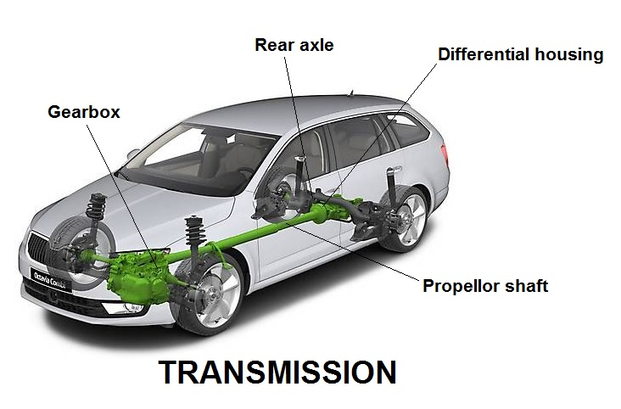
TRANSMISSION:
Its’ what that move engine power to the wheels.
Working of transmission is to enable the gear ratio between the drive wheels and engine to adjust as the car slows down and speeds up.
When a vehicle is stopped, the transmission disconnects the engine from the drive wheels.
image source: https://www.newkidscar.com/wp-content/uploads/2019/04/transmission.jpg

Slide 4
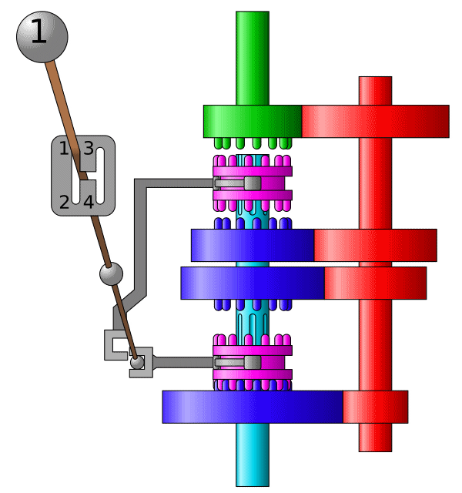
TYPE OF TRANSMISSION
1.Manual Transmission (MT)
Manual transmission, the driver selects all gears manually using both a movable gear selector and a driver-operated clutch.
also known as a “standard transmission” or a “stick shift”
image source: https://upload.wikimedia.org/wikipedia/commons/a/ac/Gearbox_4gears.gif

Slide 5
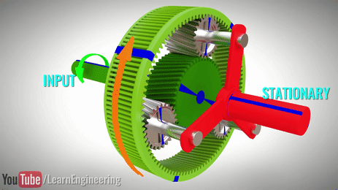
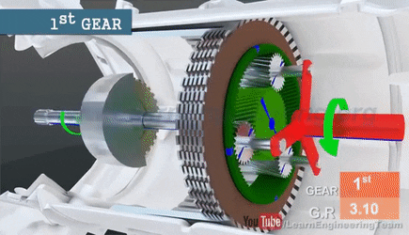
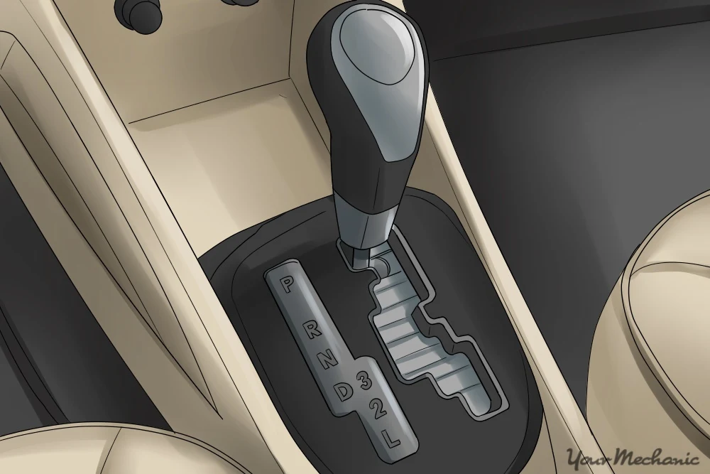
TYPE OF TRANSMISSION
2.Automatic Transmission (AT):
It uses a torque converter, planetary gearset and clutches or bands for gear shifting.
Automated Manual Transmission :
This transmission allows for either fully automatic forward gear shifts or manual shifts through the gear selector or through buttons or paddles on the steering wheel.
Image source: https://www.youtube.com/watch?v=u_y1S8C0Hmc

Slide 6
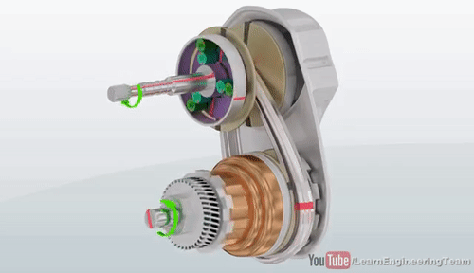
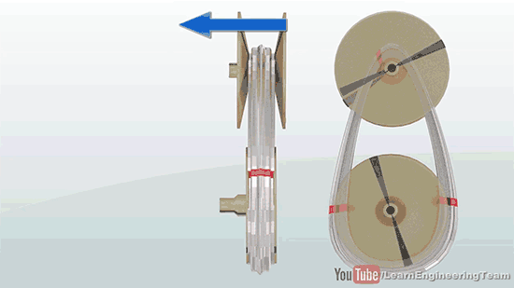
TYPE OF TRANSMISSION
3. Continuously Variable Transmission (CVT):
It uses belts, pulleys and sensors rather than gears to maintain a steady acceleration.
CVT can keep the engine in its optimum power range, thereby increasing efficiency and gas mileage.
image source: https://www.youtube.com/watch?v=PEq5_b4LWNY

Slide 7
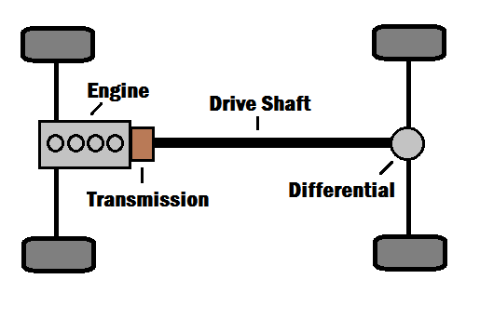
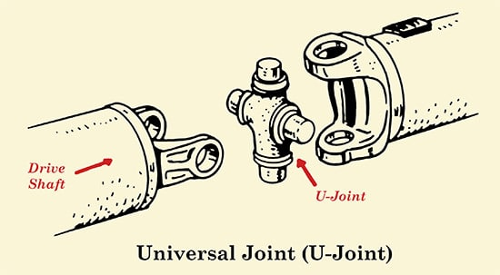
THE DRIVESHAFT
Also called propeller shaft or prop shaft.
Used to transfer torque between components that are separated by a distance
Demands maximum Safety:
1. Turning around tight corner
2. When suspension is compressed or extended
3. High acceleration
Image1 source: https://energyeducation.ca/wiki/images/a/ac/RWDcar.png
Image2 source: https://content.artofmanliness.com/uploads/2016/02/U-Joint-1.jpg

Slide 8
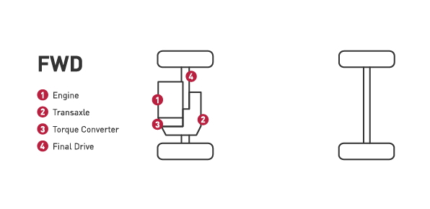
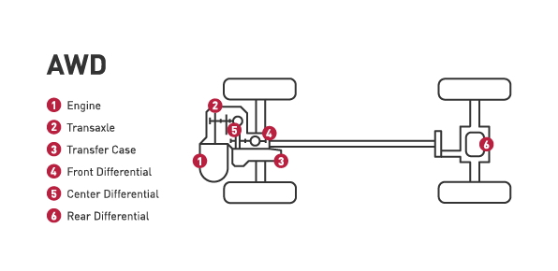
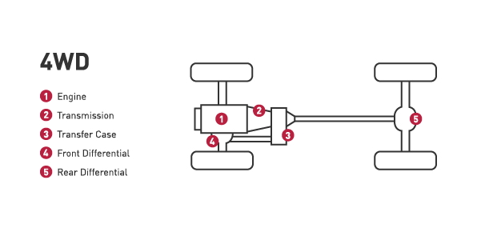
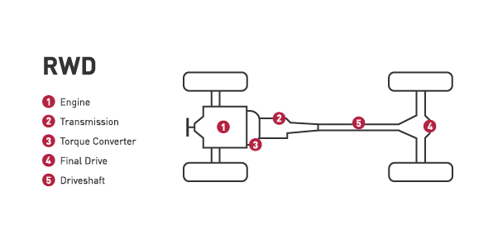
Different Driving Mode:
Image source: https://www.drivparts.com/parts-matter/learning-center/driver-education-and-vehicle-safety/drivetrain-guide.html

Slide 9
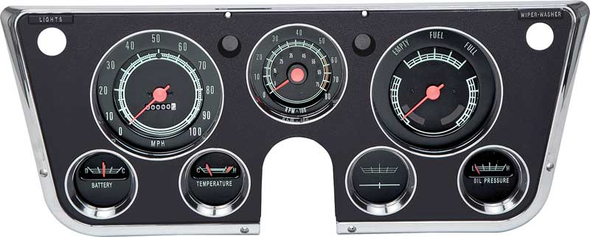
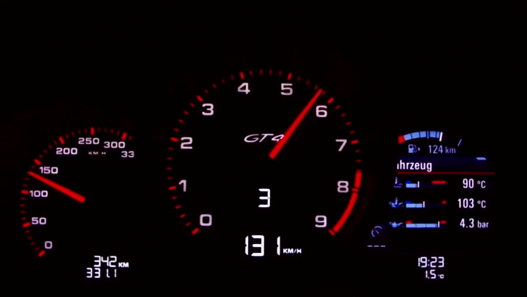
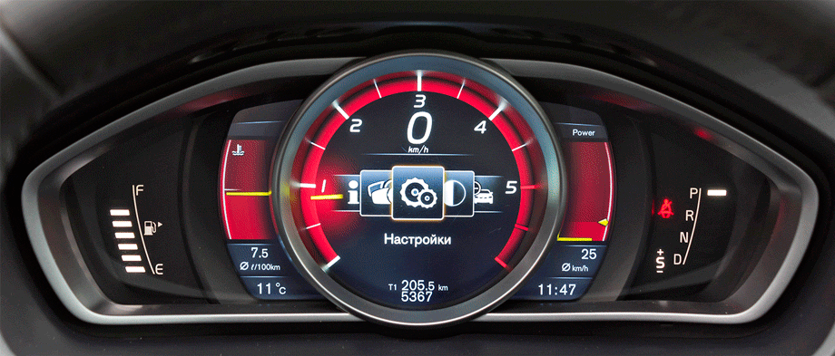
Instrument Cluster
It is a set of instrumentation, including the speedometer, that is displayed with on dashboard.
In past it comes in traditional analog gauges.
Now it comes as an electronic instrument
cluster with fully digital controls
Image1 source: https://www.autopartsdb.net/assets/images/ProductImg/C/CW1007.JPG
Image2 source: https://i.gifer.com/6f1.gif
Image3 source: https://i.pinimg.com/originals/0d/ff/87/0dff87a58306dced9ca9e9a9a1b49d0f.gif

Slide 10
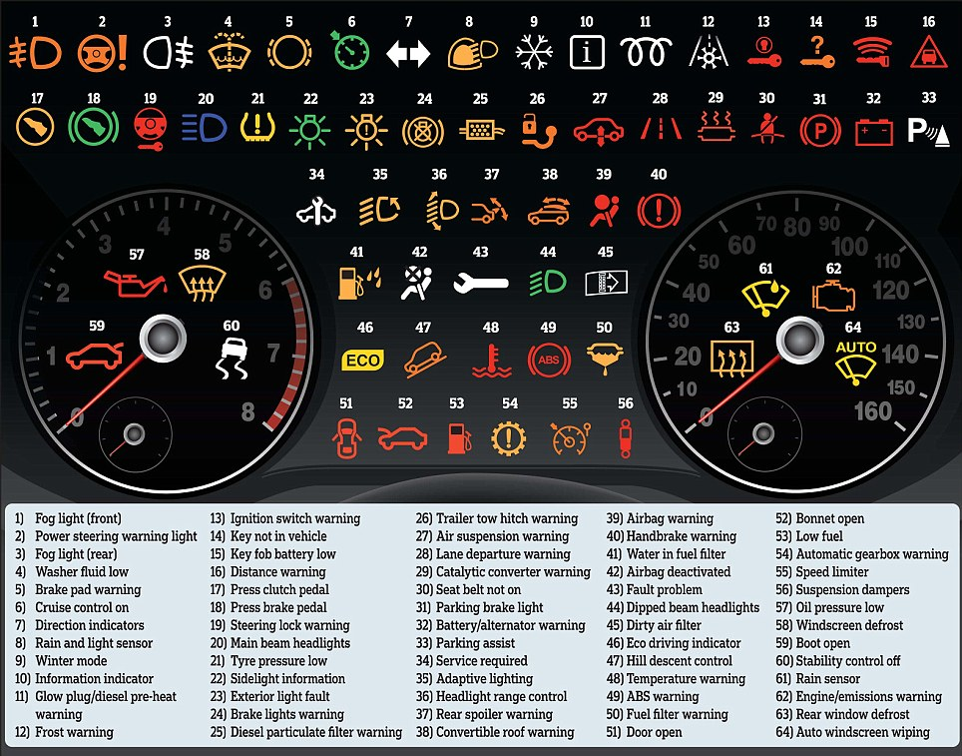
Instrument Cluster Warning Symbols and Meanings
Image source: https://www.mycarhelpline.com/images/easyblog_images/128/Car-Warning-Light.jpg

